Slide 1

Excel Hackathon project
Dataset Used: Real state company (Sample data)
Presented by:
Nikesh Maurya

Slide 2
Problem Statement
This dashboard help to understand Real state company condition
Using this one can understand total sample data taken into consideration
Variation in price of the house in 2 years
Total number convenient store and the unit area present
Total number nearby stores are available to different houses in
Price per unit area at that time
Ages of houses and their price
Near by store and ages of house to get the info regarding rebuilding

Slide 3
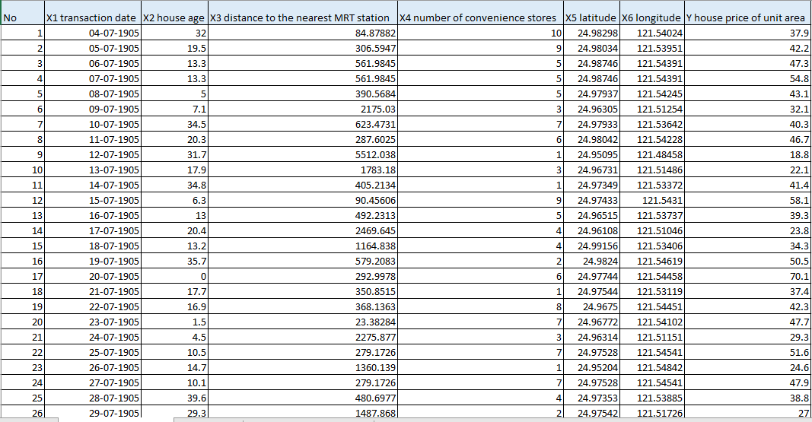
Dataset(Overview)
REAL ESTATE DATA DESCRIPTION
● Transaction date​ represents the year at which the price of the house is noted.
● Latitude and longitude​ gives exact location of house
● House age​ tells how old the house is.
● Convenient stores​ tell how many stores are available near the house.
● distance to the nearest MRT station​ describes how far is the station from the house.
● Y house price of unit area​ tells the price of house as the name suggests

Slide 4
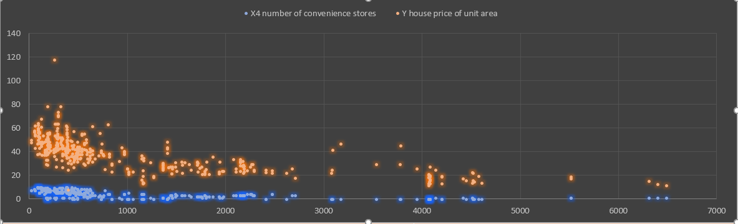
Number of store and the price of home the given area

Slide 5
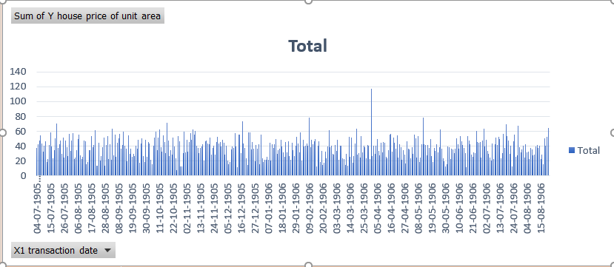
Price of unit area with time

Slide 6
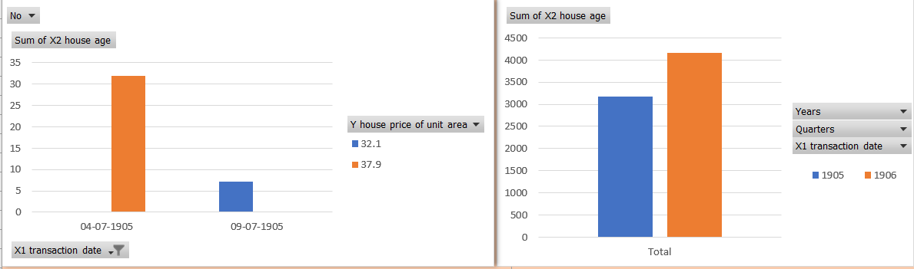
Ages of House with price and time

Slide 7
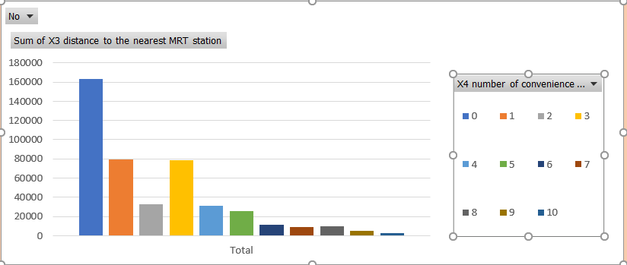
No if convience store in nearest station

Slide 8
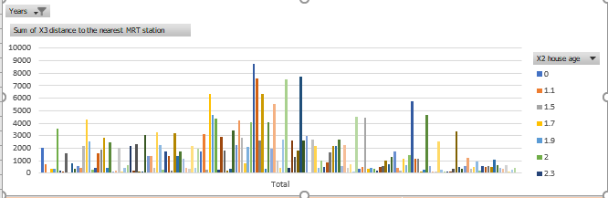

Slide 9
Conclusion
If real estate want to increase the cost of home then the home near to the station will have more value
The cost can also be taken with reference to the ages of the home as more ages home will have value more as it has the stability over time
The sale can also be increase as per demand of the price per unit are of the home
The good are i.e. location is also one of the major factor in the real estate home sales
One can also be with a profit of number of convenient store near to the home as it completed the resource availability.

